Slide 1
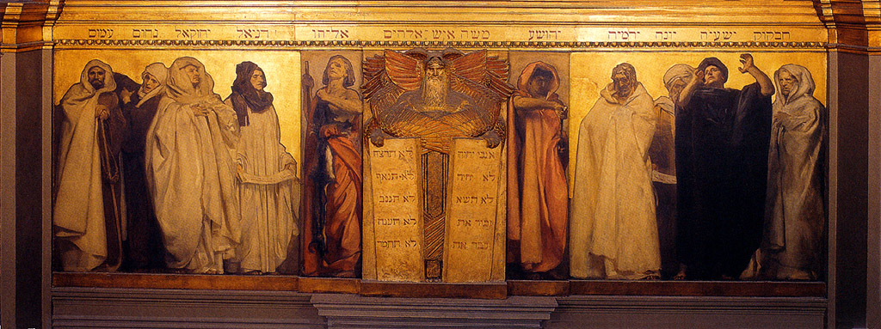
God’s Touchpoints
Old Testament Summary
The Patriarchal Ages
The Judges
The Reign of Royalty
The Prophetic Era
Old Testament (OT) Journey
Lesson 34: The Minor Prophets

Slide 2
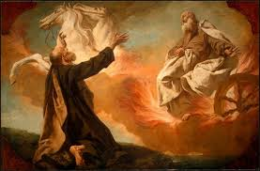
OT Journey- The Prophetic Era
The Early Prophets
Elijah, the Prophet who never died
Isaiah, the Lord has Saved
Jeremiah, Jehovah Throws
Daniel, Highly Esteemed of God
Daniel, Visions of the Future
Ezekiel, the Watchman
The Minor Prophets
Israel Restored to Receive Christ

Slide 3
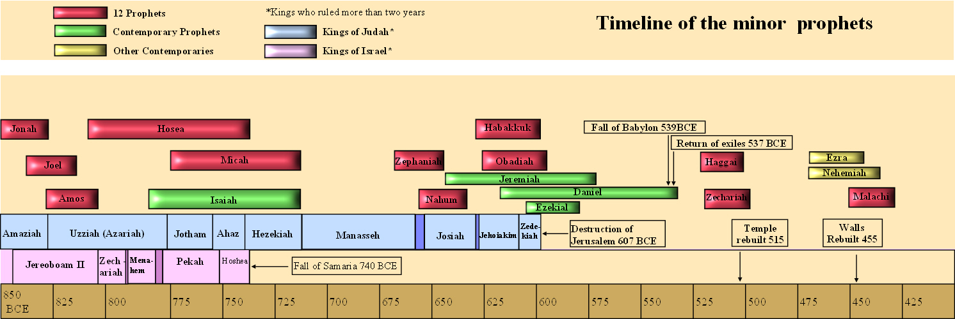
Timeline of the Prophets
Walls rebuilt 444

Slide 4
The Minor Prophets
Timeline
Summary
Some “latter days” prophecies

Slide 5
Minor Prophets – Summary [1]
Group | Book | Approximate Dates
Pre-Exilic Prophets of Israel | Jonah Amos Hosea | 780-850 765-750 755-715
Pre-Exilic Prophets of Judah | Obadiah Joel Micah Nahum Habakkuk Zephaniah | 840 835-796 740-690 630-612 606-604 625
Post-Exilic Prophets Prophets of the Returned Remnant | Haggai Zechariah Malachi | 520 515 430

Slide 6
Hosea – with the Prostitute
Object lesson to:
Israel’s “adulterous affairs”
God’s willingness to forgive

Slide 7
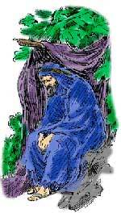
Jonah – The Reluctant Prophet
Attempted running away from God
Praised God in the belly of the fish
Complained when his message was effective at Ninevah
Furious when personal comfort was removed

Slide 8
AMOS – the Plumbline
A simple shepherd
Preached message to complacent, spiritually lazy, and hypocritical, unjust Israel
Slavery, greed, and mistreatment of the poor, rampant.

Slide 9
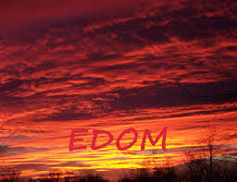
Obadiah – Judgment to Edom

Slide 10
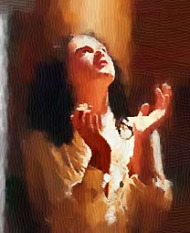
Joel
Prophesies
The Judgment as an invasion of locusts
The pouring out of the Holy Spirit

Slide 11
Micah – Right Living
Not false prophets
Not hypocritical religion,
but
obedience

Slide 12
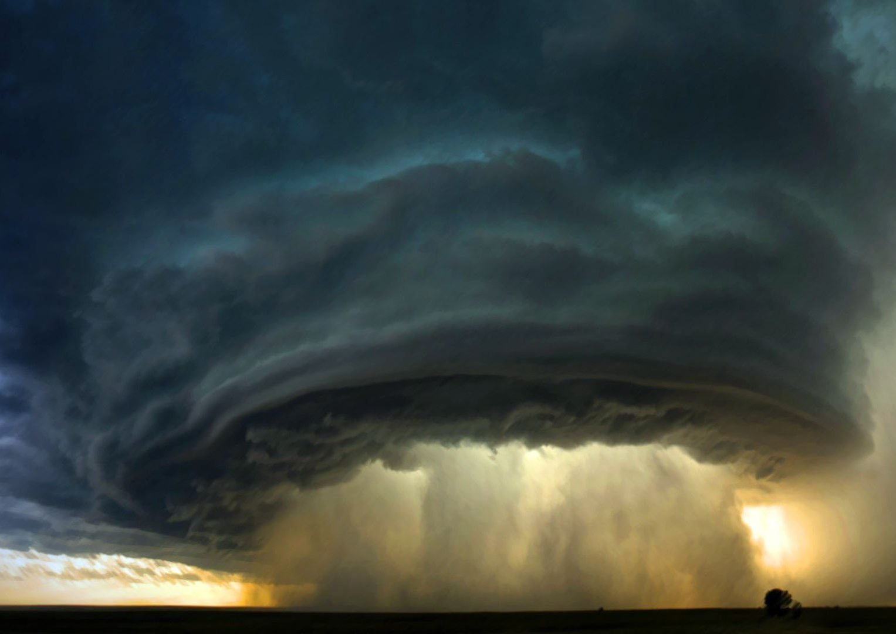
Nahum – Judgement to Assyria

Slide 13
Habakkuk – Live by Faith
Habakkuk 1:3
Habakkuk: “Why do you make me look at injustice? Why do you tolerate wrongdoing? Destruction and violence are before me; there is strife, and conflict abounds.”
God: Habakkuk 1:5 “Look at the nations and watch—and be utterly amazed
Habakkuk 2:4 “The righteous person will live by his faithfulness”

Slide 14
Zephaniah – Judgment and Restoration
Judgment to both Israel and other nations
Restoration of Israel
Zephaniah 3:9 “Then I will purify the lips of the peoples, that all of them may call on the name of the Lord and serve him shoulder to shoulder.”

Slide 15
Haggai
Haggai 2:3-5 “Who of you is left who saw this house in its former glory? How does it look to you now? Does it not seem to you like nothing? But now be strong, Zerubbabel,” declares the LORD. “Be strong, Joshua son of Jozadak, the high priest. Be strong, all you people of the land,” declares the LORD, “and work. For I am with you,” declares the LORD Almighty. “This is what I covenanted with you when you came out of Egypt. And my Spirit remains among you. Do not fear.”

Slide 16
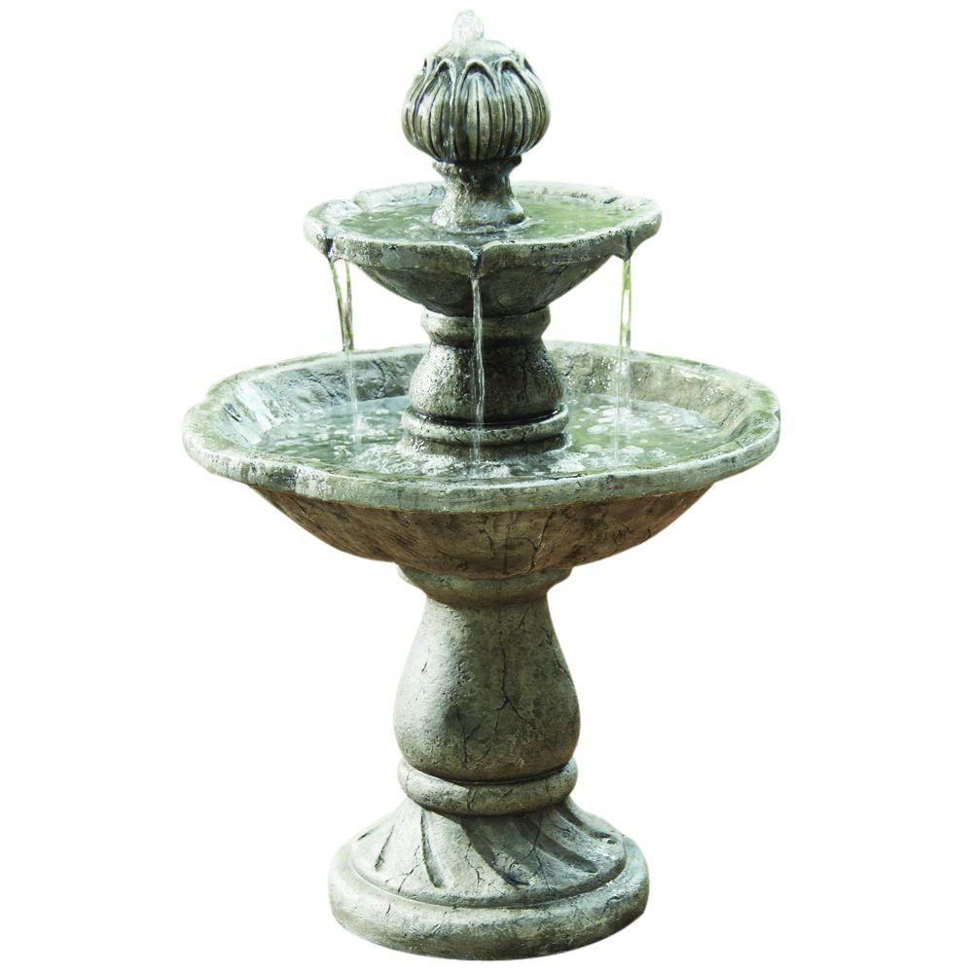
Zechariah - End Days
Mourning for the Pierced One
Zechariah 12:10 “And I will pour on the house of David and on the inhabitants of Jerusalem the Spirit of grace and supplication; then they will look on Me whom they pierced. Yes, they will mourn for Him as one mourns for his only son, and grieve for Him as one grieves for a firstborn.

Slide 17
Zechariah - End Days
Idolatry Cut Off
Zechariah 13:1 “In that day a fountain shall be opened for the house of David and for the inhabitants of Jerusalem, for sin and for uncleanness.

Slide 18
Zechariah - End Days
The Millenial Kingdom
Zechariah 14:9 And the Lord shall be King over all the earth. In that day it shall be “The Lord is one,” And His name one.10 All the land shall be turned into a plain from Geba to Rimmon south of Jerusalem. Jerusalem shall be raised up and inhabited in her place from Benjamin’s Gate to the place of the First Gate and the Corner Gate, and from the Tower of Hananel to the king’s winepresses.11 The people shall dwell in it; And no longer shall there be utter destruction, But Jerusalem shall be safely inhabited.12 And this shall be the plague with which the Lord will strike all the people who fought against Jerusalem: Their flesh shall dissolve while they stand on their feet, their eyes shall dissolve in their sockets, and their tongues shall dissolve in their mouths.

Slide 19
Zechariah - End Days
The Nations Worship the King
Zechariah 14:14 Judah also will fight at Jerusalem. And the wealth of all the surrounding nations Shall be gathered together: Gold, silver, and apparel in great abundance. 15 Such also shall be the plague. On the horse and the mule, On the camel and the donkey, And on all the cattle that will be in those camps. So shall this plague be.
16 And it shall come to pass that everyone who is left of all the nations which came against Jerusalem shall go up from year to year to worship the King, the Lord of hosts, and to keep the Feast of Tabernacles.

Slide 20
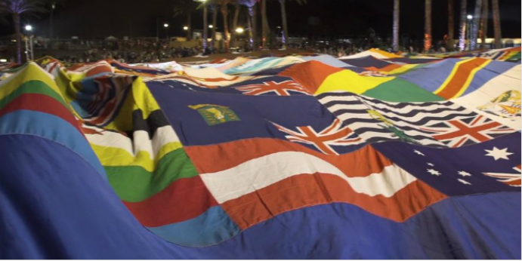
Feast of Tabernacles 2016- 20 nations
https://www.youtube.com/watch?v=7wHYGtTP_Yc
Notes:
This year’s (2016) conference will feature several dozen pro-Israel Christian parliamentarians and government officials from more than twenty countries.
Read more at https://www.breakingisraelnews.com/77283/thousands-christian-pilgrims-gather-jerusalem-affirm-support-nations-sukkot/#RYRzBtAmX1mrpQGG.99

Slide 21
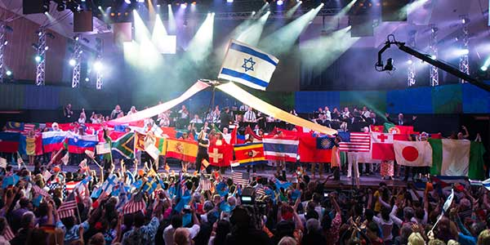
Feast of Tabernacles 2017

Slide 22
Zechariah - End Days
Holiness
Zechariah 14:20 In that day “HOLINESS TO THE LORD” shall be engraved on the bells of the horses. The pots in the Lord’s house shall be like the bowls before the altar. 21 Yes, every pot in Jerusalem and Judah shall be holiness to the Lord of hosts. Everyone who sacrifices shall come and take them and cook in them. In that day there shall no longer be a Canaanite in the house of the Lord of hosts.

Slide 23
Zechariah - End Days
The Remnant
Zechariah 13:8 And it shall come to pass in all the land,” Says the Lord,
“That two-thirds in it shall be cut off and die, But one-third shall be left in it: 9 I will bring the one-third through the fire, Will refine them as silver is refined, And test them as gold is tested. They will call on My name, And I will answer them. I will say, ‘This is My people’;
And each one will say, ‘The Lord is my God.’”

Slide 24
Malachi

Slide 25
The Prophetic Books - Flashback
“The overall picture the prophetic books paint is of a people desperately in need of a divine mediator to save them from their sin”.[2]
The stage is set for the Messiah, though few were prepared for the way he made his appearance in our world.

Slide 26
New Covenant - Recap
Jeremiah 31:31-34
"Behold, days are coming," declares the LORD, "when I will make a new covenant with the house of Israel and with the house of Judah, not like the covenant which I made with their fathers in the day I took them by the hand to bring them out of the land of Egypt, My covenant which they broke, although I was a husband to them," declares the LORD. "But this is the covenant which I will make with the house of Israel after those days," declares the LORD, "I will put My law within them and on their heart I will write it; and I will be their God, and they shall be My people. "They will not teach again, each man his neighbor and each man his brother, saying, 'Know the LORD,' for they will all know Me, from the least of them to the greatest of them," declares the LORD, "for I will forgive their iniquity, and their sin I will remember no more.“ (Also quoted in Hebrew 8:4-13)
Notes:
Term occurs only in Jeremiah and same is quoted in Hebrews

Slide 27
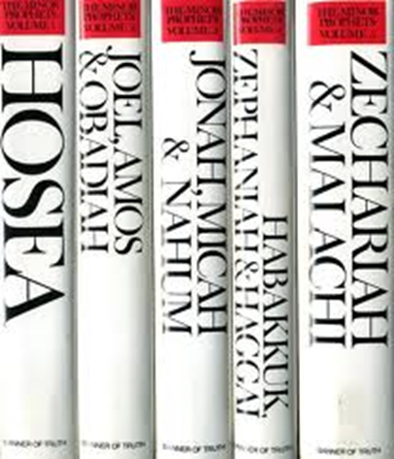
Discussion
What are key takeaways from the minor prophets?
How can we set the stage for Christ’s second coming?

Slide 28
References
Bible.org
Biblegateway.com
Dr. Heinz Lycklama

