Slide 1
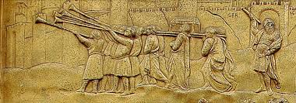
God’s Touchpoints
Old Testament (OT) Summary
The Patriarchal Ages
The Judges
The Royal Verses
The Prophetic Era
Old Testament (OT) Journey
Lesson 17: Ruth, Familiarity to Faith

Slide 2
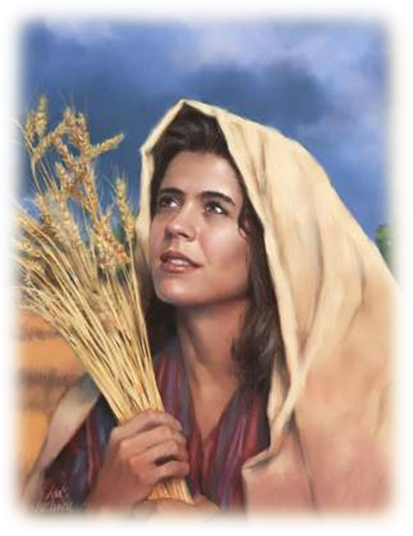
OT Journey - The Judges
Joshua: The Land of Rest
Judges: Slipping from the promises
Ruth: Familiarity to Faith
Hannah: The Liberated Woman

Slide 3
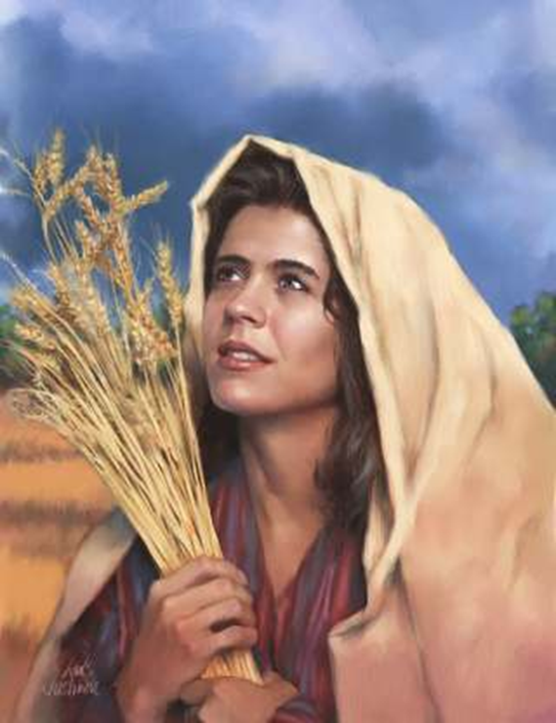
Ruth – Familiarity to Faith
Ruth – a background
Accountability and Perception
Discussion
Accountability and Choice
Accountability and Attitude
Discussion

Slide 4
Ruth – A Background: Names and Story Line
Elimelech -God is king
Naomi –Pleasant
Marah – Bitter
Mahlom – Sickly
Chilom – Failing
Ruth – Friendship
Orphah – Stubborn/Stiff
Boaz – Swift Strength
Bethlehem – House of Bread.

Slide 5
Ruth – A Background: Moabitess
Their origin – Genesis 19: 36,37
Moab sounds like the Hebrew for “from father”.
Their condemnation – Deuteronomy 23:3
Cursed upto 10 generations. Ruth was the 8th
“Ruth, the Moabitess” mentioned 6 times
Notes:
“So both of Lot's daughters became pregnant by their father.
The older daughter had a son, and she named him Moab^{[1]} ; he is the father of the Moabites of today.”
Ruth, the Moabitess is mentioned 6 times
1:21-23 So Naomi returned from Moab accompanied by Ruth the Moabitess, her daughter-in-law,...
2:1-3 And Ruth the Moabitess said to Naomi, "Let me go to the fields and pick up the leftover grain behind anyone in whose eyes I find favor…."
2:5-7 The foreman replied, "She is the Moabitess who came back from Moab with Naomi.
2:20-22 Then Ruth the Moabitess said, "He even said to me, `Stay with my workers until they finish harvesting all my grain.'"
4:4-6 Then Boaz said, "On the day you buy the land from Naomi and from Ruth the Moabitess,.."
4:9-11 I have also acquired Ruth the Moabitess,..

Slide 6
Ruth – Fast Forward: Geneology
Genealogy of Jesus according to Matthew
Abraham Isaac Jacob Judah & Tamar Perez Hezron Ram | Amminadab Nahshon Salmon & Rahab Boaz & Ruth Obed Jesse David & Bathsheba | Solomon & Naamah Rehoboam Abijam Asa Jehosaphat Jehoram Uzziah | Jotham Ahaz Hezekiah Manasseh Amon Josiah Jeconiah | Shealtiel Zerubbabel Abiud Eliakim Azor Zadok Achim | Eliud Eleazar Matthan Jacob Joseph & Mary Jesus
Notes:
In ed are the women in the NT, among whom are Ruth. Noteably Rahab is Ruth’s new mother in law.

Slide 7
Ruth: Familiarity to Faith
What was Ruth’s direct experience with this Jewish family?
What was the basis of Ruth’s choice?
Ruth 1:17
Ruth 2:11,12
Notes:
Her direct experience with the Jews was famine and death other than a strong affection for Naomi, an empty widow.

Slide 8
Ruth: Accountability to God
Ruth 1:17 Where you die I will die, and there I will be buried. May the Lord deal with me, be it ever so severely, if even death separates you and me.
Ruth 2:11,12 ‘Boaz replied,… “May you be richly rewarded by the Lord, the God of Israel, under whose wings you have come to take refuge.”’
Notes:
Ruth 2:11,12 ‘Boaz replied, “I’ve been told all about what you have done for your mother-in-law since the death of your husband—how you left your father and mother and your homeland and came to live with a people you did not know before. May the Lord repay you for what you have done. May you be richly rewarded by the Lord, the God of Israel, under whose wings you have come to take refuge.”’

Slide 9
The driver of Ruth’s choice
was
Accountability
To God

Slide 10
Accountability to God Transforms
PERCEPTION (What you see)
ATTITUDE (What you think and feel)
CHOICES (What you decide)
ACTIONS (What you do)

Slide 11
Accountability and Perception Discussion
In the book of Ruth, what are the perceptions of Orpah, unknown kinsman, Ruth, Boaz, Naomi. Share.
References:
Elimelech: Judges 21:25, Ruth 1:2,3
Orpah: Ruth 1:9-13
Unknown kinsman: Ruth 4:2-6
Naomi: Ruth 1:20
Boaz: Ruth3:10-14
Ruth: Ruth 2:12
How did their belief window impact their behavior? Did it meet their needs?
Notes:
Note to leader: Print this slide with the table in the next slide on a word document. Make copies and distribute to participants. Divide into groups covering different names above. Get them to discuss and come back and share.

Slide 12
Discussion
Fill the following table:
Name | Belief window | Right or wrong? | Behaviour | Were needs met?
Elimelech
Orpah
Unknown kinsman
Naomi
Boaz
Ruth
Christian

Slide 13
Accountability and Perception
The unknown kinsman saw a moabitess, a widow and a lost inheritance
Orpah saw her widowhood, famine, a dead hope and a old widowed mother in law.
Ruth sees her accountability to God, a loving mother in law and a heritage with God’s people.
Boaz saw a devoted lady, a woman of noble character, a relative and a great heritage
Naomi sees her emptiness and abandonment by God

Slide 14
Ruth: Accountability and Choices
Contrast Ruth’s choices with other choices made – Elimelech, his sons, etc.
Who were they accountable to?
How can we demonstrate accountability to God in:
Big decisions?
Daily choices?

Slide 15
Accountability and Choices
Only Ruth demonstrated a strong and clear accountability to God
Faith to Food
Elimelech left God’s people for the condemned Moabites
Faith to Foreigners
Mahlon and Chilion marry Moabite women
Naomi goes back to Bethlehem when she hears there is food
Familiarity to Faith
Ruth sees a powerful God she was accountable to for life
Foreigners to Familiarity

Slide 16
Accountability and Attitude, Action – Gods Response
Ruth’s Attitude | Ruth’s Action | God’s Response
Humbles herself | Gives herself completely to work as a poor gleaner Risks rape, abuse | God leads her to a field where she will be cared for and protected
Serves her mother in law | Works for her Cooks for her | God gives her a saviour in Boaz
Obeys without question | Spends the night in Boaz’s barn Asks him to “cover” her | God gives her a new life and makes her part of a royal heritage

Slide 17
Recap:Accountability to God Transforms
Accountability can transform your life by transforming:
PERCEPTION (What you see)
ATTITUDE (What you think and feel)
CHOICES (What you decide)
ACTIONS (What you do)

Slide 18
Video Clip:Perception
https://www.youtube.com/watch?v=3xwLvq44Gsk

Slide 19
I learned in an extremely hard way that the accountability falls with me. Stephen Baldwin

Slide 20
References
Ruth: Choices and Decision Making – Anand Pillai

