Slide 1
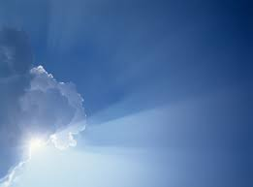
GOD REVEALED
The Gospels
Acts of the Apostles
Paul’s Letters
Powerful Letters
Revelation
A New Testament Journey
Lesson 24: 1 John – Enjoy Fellowship

Slide 2
Other Letters/ Epistles
Hebrews – The Real Deal
James – All or nothing
1 Peter – Dimensions of Suffering
2 Peter – Darkness before Dawning
1 John – Enjoy Fellowship
2 John – Love in Truth
3 John – Model the Gospel
Jude – Keep your Position
Notes:
The Epistles of the Bible are all found in the New Testament. They include 21 of the New Testament’s 27 books, extending from Romans to Jude. Thirteen of these Epistles were written by the apostle Paul: Romans, 1 and 2 Corinthians, Galatians, Ephesians, Philippians, Colossians, 1 and 2 Thessalonians, 1 and 2 Timothy, Titus, and Philemon. Within this group of Pauline Epistles is a subgroup labeled the Prison Epistles (Ephesians, Philippians, Colossians, and Philemon) so-called because they were written during Paul’s two-year house arrest in Rome (Acts 28:30–31). The Pastoral Epistles (1 and 2 Timothy and Titus) were written to church leaders and include many teachings regarding practices within the early church. Following these writings are eight General Epistles (sometimes called Catholic Epistles, since they were written to a “universal” audience) that include Hebrews, James, 1 and 2 Peter, 1, 2, and 3 John, and Jude. The author of Hebrews is unknown (though many have historically attributed it to Paul or one of Paul’s associates). James was one of the earliest New Testament writings and was written by James, the half-brother of Jesus (1 Corinthians 15:7). The apostle Peter wrote 1 and 2 Peter. The apostle John (the same author of the Gospel of John and Revelation) wrote 1 John, 2 John, and 3 John. The short Epistle of Jude was written by Jude, another half-brother of Jesus (Jude 1:1). All of the known authors of the Epistles are either an apostle (Paul, Peter, John) or a family member of Jesus (James, Jude). Each of these individuals had a unique calling from the Lord Jesus that included writing letters to others. These letters, inspired by the Holy Spirit, are preserved as part of the New Testament’s writings today. Read more:http://www.gotquestions.org/what-is-an-epistle.html#ixzz3eBIfeAM6

Slide 3
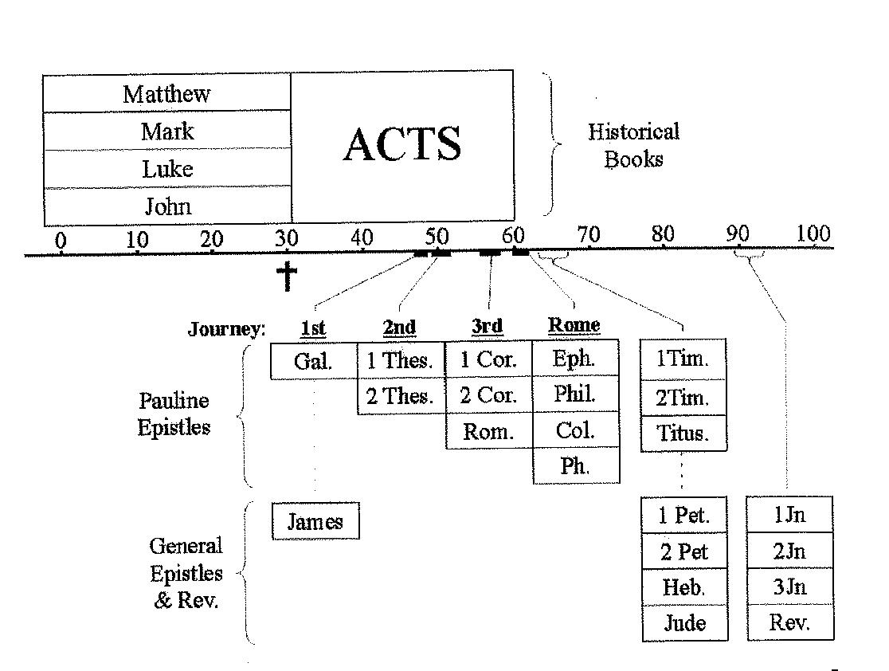
EVENT TIMELINE OF THE NEW TESTAMENT

Slide 4
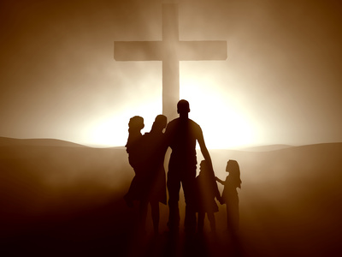
Enjoy Fellowship
Walk in the light (ch 1,2)
Fellowship
Cleansing
Obedience
Knowledge
Love
Grow in purity (ch 3,5)
Steadfast Hope (ahead)
Eternal seed (within)
Atmosphere of God (around)
Confidence in Prayer (upward)
Discern the spirits (ch 4)
Spirit of Christ
Spirit of Antichrist
Spirit of Truth
Spirit of Falsehood

Slide 5
Enjoy Fellowship Theme Verse
1 John1:3 what we have seen and heard we proclaim to you also, so that you too may have fellowship with us; and indeed our fellowship is with the Father, and with His Son Jesus Christ. 4 These things we write, so that our joy may be made complete.

Slide 6
Walk in the Light Fellowship
1 John 1:³ what we have seen and heard we proclaim to you also, so that you too may have fellowship with us; and indeed our fellowship is with the Father, and with His Son Jesus Christ.
⁶ If we say that we have fellowship with Him and yet walk in the darkness, we lie and do not practice the truth;

Slide 7
Walk in the Light
sin
Love for world
Lust of flesh
Lust of eyes
Pride of life (2:16)
Practicing
Knowledge,
word of God,
Prayer (2:6)
Love for God
Will of God
Walk like Jesus (2:15.17)
By Suramya
Notes:
To maintain connect with God, sin is the “off” switch which can disconnect us from God. Love of the world is the resistence reducing our connect with God (like the circuit resistence) and battery is the practice and knowledge of God and abiding in Him.

Slide 8
Walk in the Light Cleansing
1 John 1:7 but if we walk in the Light as He Himself is in the Light, we have fellowship with one another, and the blood of Jesus His Son cleanses us from all sin.

Slide 9
Walk in the Light Obedience
1 John 2:3 By this we know that we have come to know Him, if we keep His commandments.

Slide 10
Walk in the Light Knowledge
1 John 2:3 By this we know that we have come to know Him, if we keep His commandments.

Slide 11
Walk in the Light Love
1 John 2:10 The one who loves his brother abides in the Light and there is no cause for stumbling in him. 11 But the one who hates his brother is in the darkness and walks in the darkness, and does not know where he is going because the darkness has blinded his eyes.
Notes:
Those who know know that they know
Those who don’t know don’t know that they don’t know

Slide 12
Enjoying Fellowship Grow in Purity
Steadfast Hope (ahead)
Eternal seed (within)
Atmosphere of God (around)
Confidence in Prayer (upward)

Slide 13
Grow in Purity Steadfast Hope
1 John 3:³ And everyone who has this hope fixed on Him purifies himself, just as He is pure.

Slide 14
Grow in Purity Eternal Seed
⁹ No one who is born of God practices sin, because His seed abides in him; and he cannot sin, because he is born of God. Ch 3
Notes:
….because he is born of God. 10 By this the children of God and the children of the devil are obvious: anyone who does not practice righteousness is not of God, nor the one who does not love his brother. Ch 3
It is not possible for one with God’s seed to “continue in sin”

Slide 15
Grow in Purity Eternal Seed
Purity
3:3)
Challenge: How do we respond when our hearts condemn us?
love
(3:16)
By Swati
Sacrifice /lay dow life
3:16
Sharing (3:17)
Actions
(3:22)
Responsive Conscience
(3:21)
Notes:
The main root is a responsive conscience substantiated by actions, sharing and willingness to sacrifice – sub roots.
The fruits are love and purity in our lives..

Slide 16
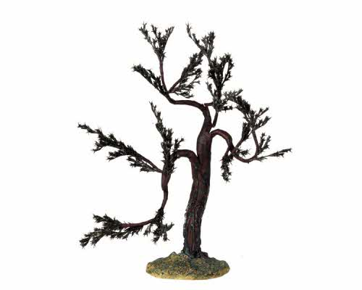
Grow in Purity Cont’d.. Eternal Seed
Death
5:16
death
hatred
Hatred (4:20)
By Swati
Weak conscience
Weak conscience
3:17
Continual sin
Continual sin
5:16
Notes:
IF the main root is a weak conscience supported by continual sin (sub roots) – result is hatred and death

Slide 17
Grow in Purity Atmosphere of God
1 John 3:24 The one who keeps His commandments abides in Him, and He in him.
The term abide means “remaining in the atmosphere of”

Slide 18
Grow in Purity Confidence in Prayer
1 John 3:21 Beloved, if our heart does not condemn us, we have confidence toward God. 22 And whatever we ask we receive from Him,

Slide 19
Grow in Purity Confidence in Prayer
1 John 5:14 Now this is the confidence that we have in Him, that if we ask anything according to His will, He hears us.

Slide 20
Grow in Purity Confidence in Prayer
1 John 5:16 If anyone sees his brother committing a sin not leading to death, he shall ask and God will for him give life to those who commit sin not leading to death. There is a sin leading to death; I do not say that he should make request for this.
Notes:
And this seems to be the meaning of "sin unto death; "willful and obstinate rejection of God's grace and persistence in unrepented sin. "Death" - bible.hub, pulpit commentary

Slide 21
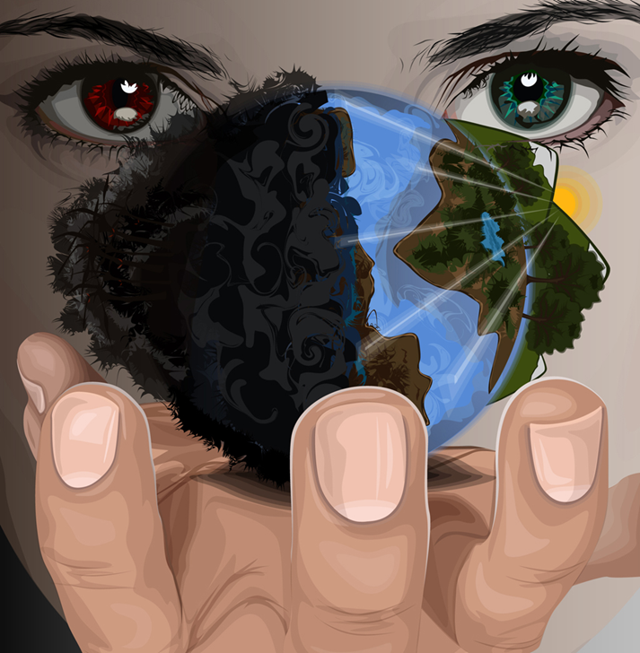
Enjoy Fellowship Discern the Spirits
1 John 4:1 Beloved, do not believe every spirit, but test the spirits to see whether they are from God, because many false prophets have gone out into the world.
Spirit of Christ
Spirit of Antichrist
Spirit of Truth
Spirit of Falsehood

Slide 22
Discern the Spirits Spirit of Christ
1 John 4:2 By this you know the Spirit of God: every spirit that confesses that Jesus Christ has come in the flesh is from God;
Notes:
The confession should be from the heart as well ..not only from the mouth.

Slide 23
Discern the Spirits Spirit of Antichrist
1 John 4:3 and every spirit that does not confess Jesus is not from God; this is the spirit of the antichrist, of which you have heard that it is coming, and now it is already in the world.

Slide 24
Discern the Spirits Spirit of Truth
1 John 4:6 We are from God; he who knows God listens to us; he who is not from God does not listen to us. By this we know the spirit of truth and the spirit of error.

Slide 25
Discern the Spirits Spirit of Truth
1 John 5:3 For this is the love of God, that we keep His commandments; and His commandments are not burdensome.
Notes:
5:6-8 We are inwardly and outwardly defiled; inwardly, by the power and pollution of sin in our nature. For our cleansing there is in and by Christ Jesus, the washing of regeneration and the renewing of the Holy Ghost. Some think that the two sacraments are here meant: baptism with water, as the outward sign of regeneration, and purifying from the pollution of sin by the Holy Spirit; and the Lord's supper, as the outward sign of the shedding Christ's blood, and the receiving him by faith for pardon and justification. Both these ways of cleansing were represented in the old ceremonial sacrifices and cleansings. This water and blood include all that is necessary to our salvation – Matthew Henry’s Commentary

Slide 26
Discern the Spirits Spirit of Falsehood
1 John 4:1many false prophets have gone out into the world.
1 John 4:6 he who is not from God does not listen to us. By this we know the spirit of truth and the spirit of error.

Slide 27
आत्माओं को परखो Discern the Spirits (1 यूहन्ना 4)
Spirit of Christ (believer)
Confesses Christ
Has Spirit of Truth
Spirit of Antichrist (unbeliever)
Does not Confess Christ
Has mostly Spirit of Falsehood
Beyond Redemption ( LIVING DEAD unbeliever)
Has spirit of antichrist
Is filled with falsehood – (completely unresponsive to Holy spirit)
Listens to word
Obeys word (growing)
Respects Godly counsel
Does not listen to word (partial response)
Does not respect godly counsel
Disobeys word
Notes:
The Spirit of God/ spirit of Christ has complete truth, no falsehood at all. On the flip side the spirit of the antichrist is complete falsehood – no truth at all. Most of us, though have a mix of the two. The saved have less spirit of falsehood and more spirit of truth and increasingly increase the “truth” component in our lives. The unsaved are vice versa. The “living dead” are those “unsaved” who sin unto death – ie those who have resisted God so much they can never turn to God at all…they too reflect the spirit of falsehood – no truth at all…no conscience, etc.
The unsaved, depending to their response can go to either of the 3 categories – saved, hell or living dead.

Slide 28
Listen to Conscience (Holy Spirit) - video
https://www.youtube.com/watch?v=HHtpdfOBF9M
True story of Desmond Doss

Slide 29
आत्माओं को परखो Discern the Spirits (1 यूहन्ना 4)
In today’s evil world, deception is so high that externals are almost undiscernable between believer and unbeliever. Only the Holy spirit can help us discern the spirits
Notes:
The Spirit of God/ spirit of Christ has complete truth, no falsehood at all. On the flip side the spirit of the antichrist is complete falsehood – no truth at all. Most of us, though have a mix of the two. The saved have less spirit of falsehood and more spirit of truth and increasingly increase the “truth” component in our lives. The unsaved are vice versa. The “living dead” are those “unsaved” who sin unto death – ie those who have resisted God so much they can never turn to God at all…they too reflect the spirit of falsehood – no truth at all…no conscience, etc.
The unsaved, depending to their response can go to either of the 3 categories – saved, hell or living

Slide 30
Where do we stand?
1 John 5:11 And the testimony is this, that God has given us eternal life, and this life is in His Son. 12 He who has the Son has the life; he who does not have the Son of God does not have the life.
Fold of Hell
Fold of Heaven
Undecided
Notes:
1 John 5 assures that those in whom God’s seed resides are already part
Of the Heavenly Kingdom and can never be snatched away. On the flip side
There are those who by constantly resisting the Spirit are already part of Satan’s
Kingdom. Most of the population are still not in either but if they remain
In the current condition will also be in Satan’s Kingdom. Time is short. Stakes are high

Slide 31
Where do we stand?
1 John 5:19 We know that we are of God, and that the whole world lies in the power of the evil one.
Fold of Heaven
Fold of Hell
Undecided
Notes:
Most of the population are still not in either but if they remain
In the current condition will also be in Satan’s Kingdom. Time is short. Stakes are high

Slide 32
Enjoy Fellowship - Recap
Walk in the light (ch 1,2)
Fellowship
Cleansing
Obedience
Knowledge
Love
Grow in purity (ch 3,5)
Steadfast Hope (ahead)
Eternal seed (within)
Atmosphere of God (around)
Confidence in Prayer (above)
Discern the spirits (ch 4)
Spirit of Christ
Spirit of Antichrist
Spirit of Truth
Spirit of Falsehood

Slide 33
Enjoy Fellowship Discussion
Can we be sure of our salvation in this world itself?
How are we sure of our salvation? (2:3,5:3,11,12 and others)
What kind of people is it useless to pray for? Why? (5:16) When are our prayers heard? (5:3,5)
What is the importance of listening to our heart? (3:17-22)

Slide 34
References
Matthew Henry’s Commentary

